Slide 1



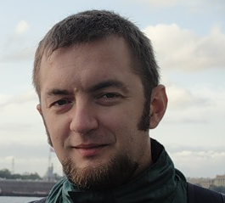

Train for trainers – open source in the cloud / Warsaw, 2013 /
#ms_oss
TITLE OF YOUR PRESENTATION:
YESTERDAY
ALL MY TROUBLES SEEMS SO FAR AWAY
abokov@microsoft.com
Alexey Bokov
Windows Azure evangelist
@azure_cee

Slide 2

Title
Some text

Slide 3
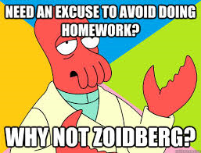
TASK / HOMEWORK
Please run simple monte carlo simulation app ( source may be found here : _some_link )
Modify it to work with Cassandra – add methods kill_them_all, destroy_vm, make_all_happy()l
Commit your code into github.com with readme

Slide 4







Online resources
msopentech.com
Open technologies in CEE
opennessatcee.com
CEE Azure user group in Facebook
facebook.com/groups/azurecee
Last new in our twitter
@azure_cee
Open technologies in CEE
@OpennessAtCEE
All questions about Azure in CEE
azure_cee@microsoft.com

